Slide 1

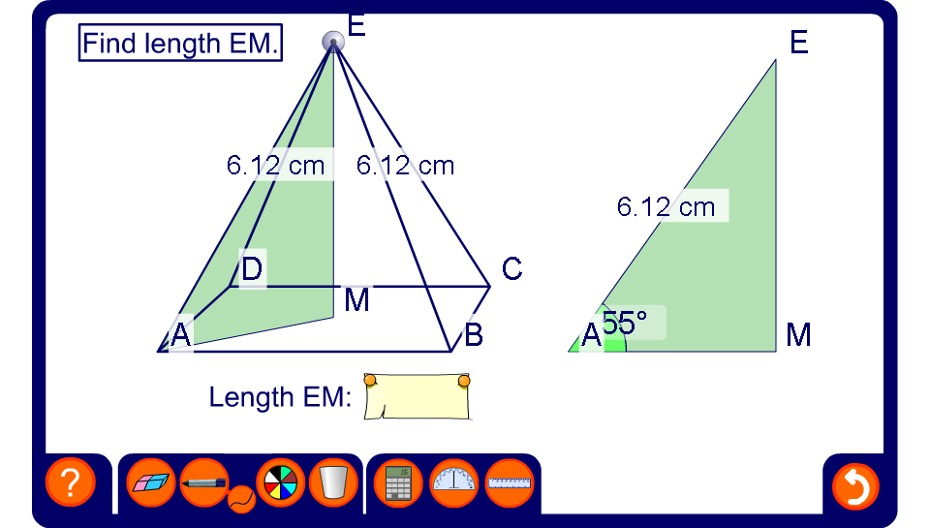


Lengths in a square-based pyramid
Notes:
Tell pupils that the point M is directly below point E. Point E can be moved to change the angle between the base and the sloping side.
Demonstrate how to find the length of EM using the sine ratio.
Reveal the answer. If there is a small discrepancy, this is due to rounding.
Change the height of the pyramid by dragging on point E and ask a volunteer to calculate the new pyramid height EM.
Ask pupils if it is possible to find the length of the side of the square base AB.
Challenge pupils to find the length of AB using a combination of trigonometry and Pythagoras’ theorem.

